Slide 1
THE STATE OF CANCER IN FLORIDA | 2024

Slide 2
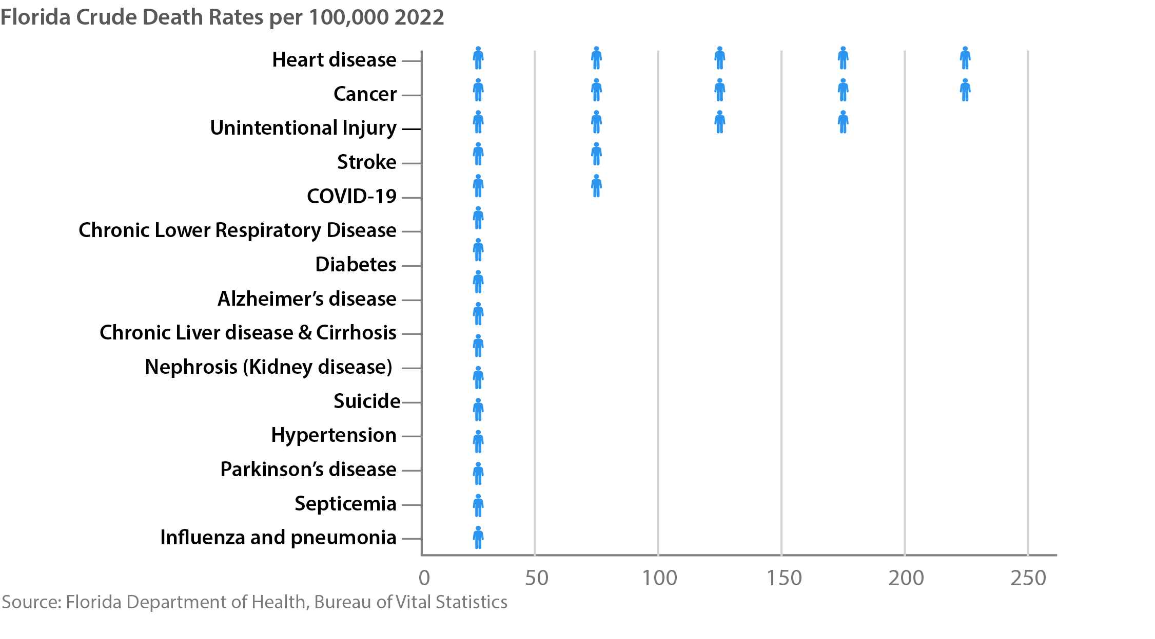
Leading Causes of Death in Florida
THE STATE OF CANCER IN FLORIDA | 2024

Slide 3
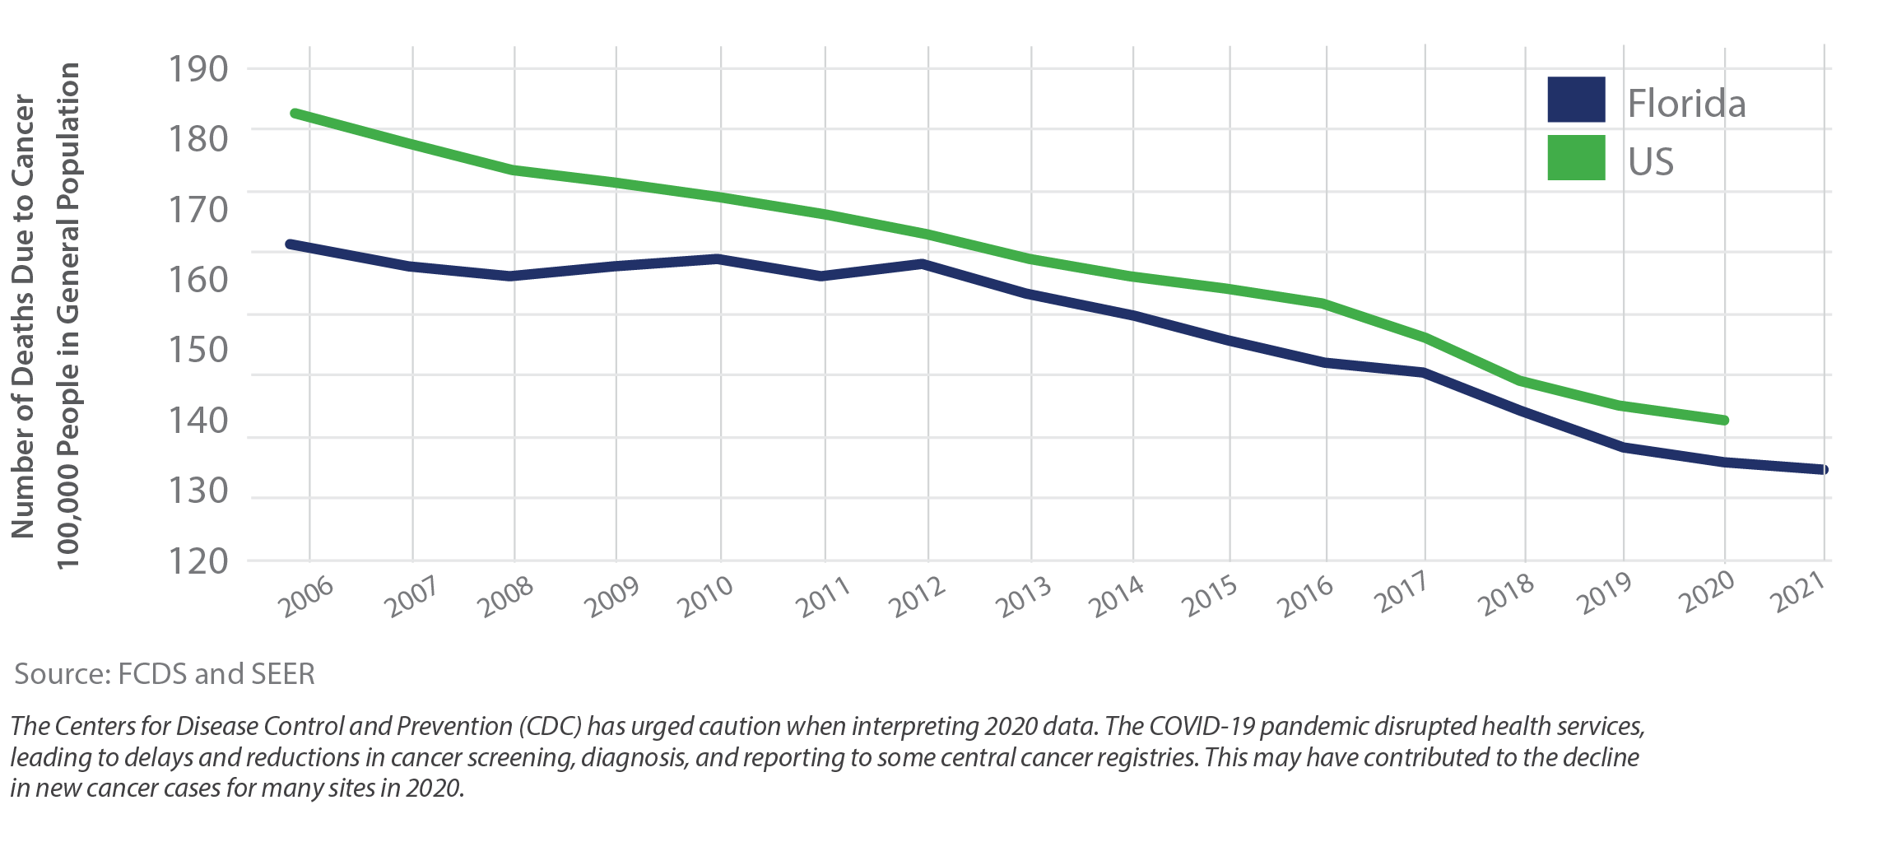
Cancer Mortality in Florida vs. the United States
THE STATE OF CANCER IN FLORIDA | 2024

Slide 4
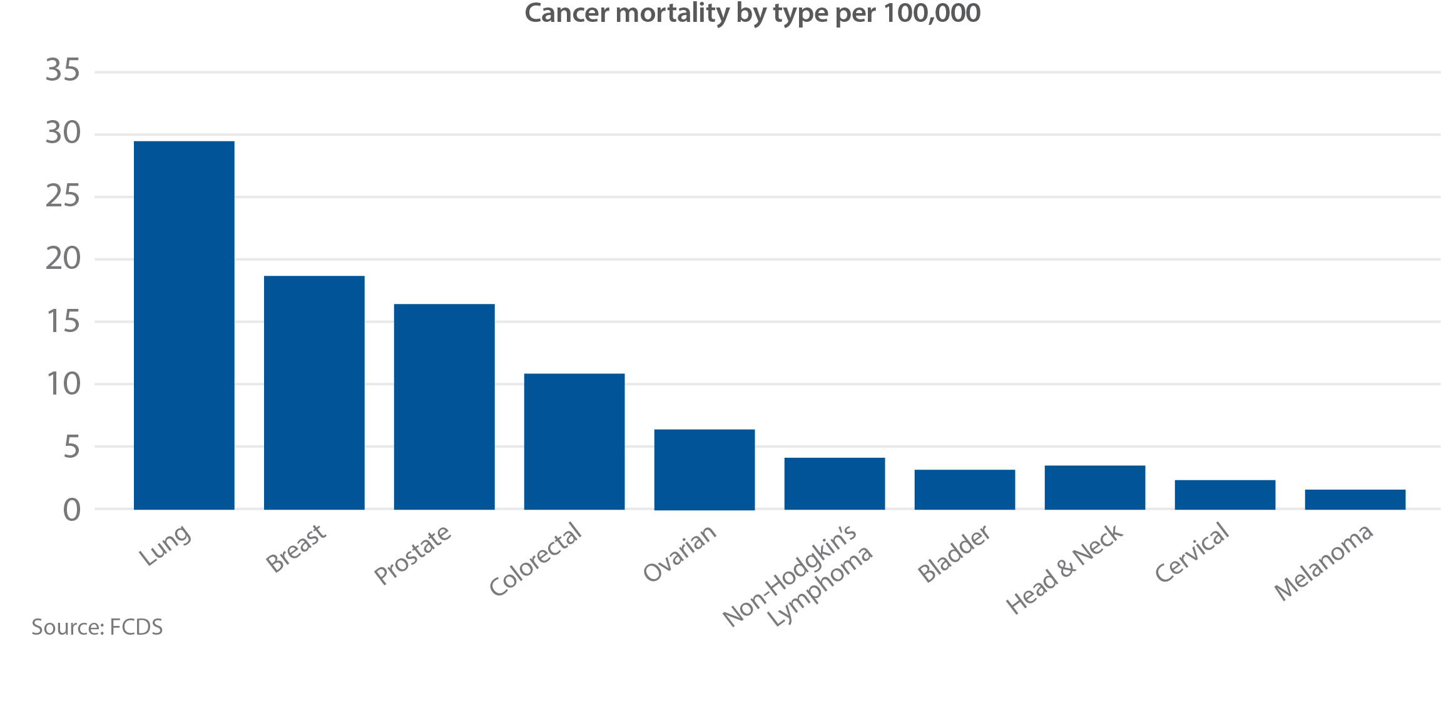
Cancer Mortality by Type in Florida, 2021
THE STATE OF CANCER IN FLORIDA | 2024

Slide 5
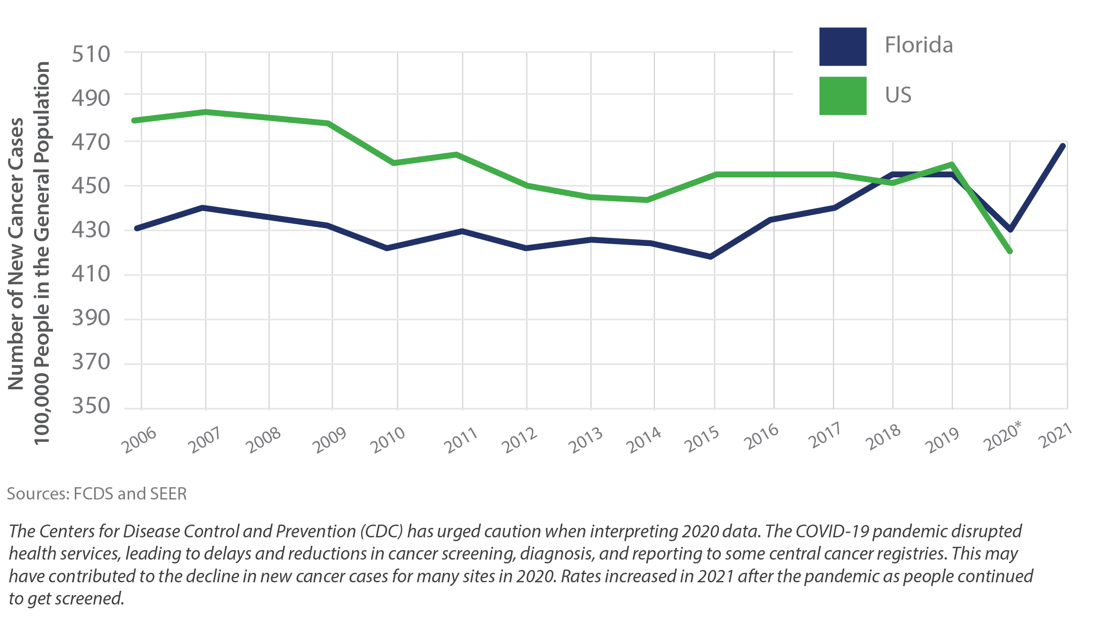
Cancer Incidence in Florida vs. the United States
THE STATE OF CANCER IN FLORIDA | 2024

Slide 6
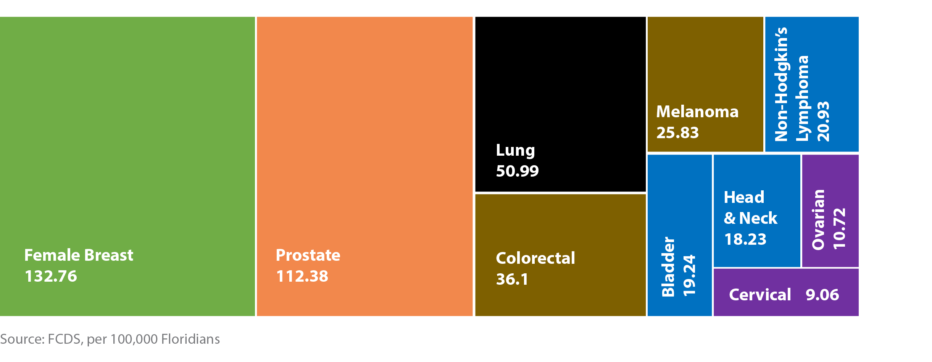
Age-Adjusted Cancer Incidence by Type in Florida
THE STATE OF CANCER IN FLORIDA | 2024

Slide 7
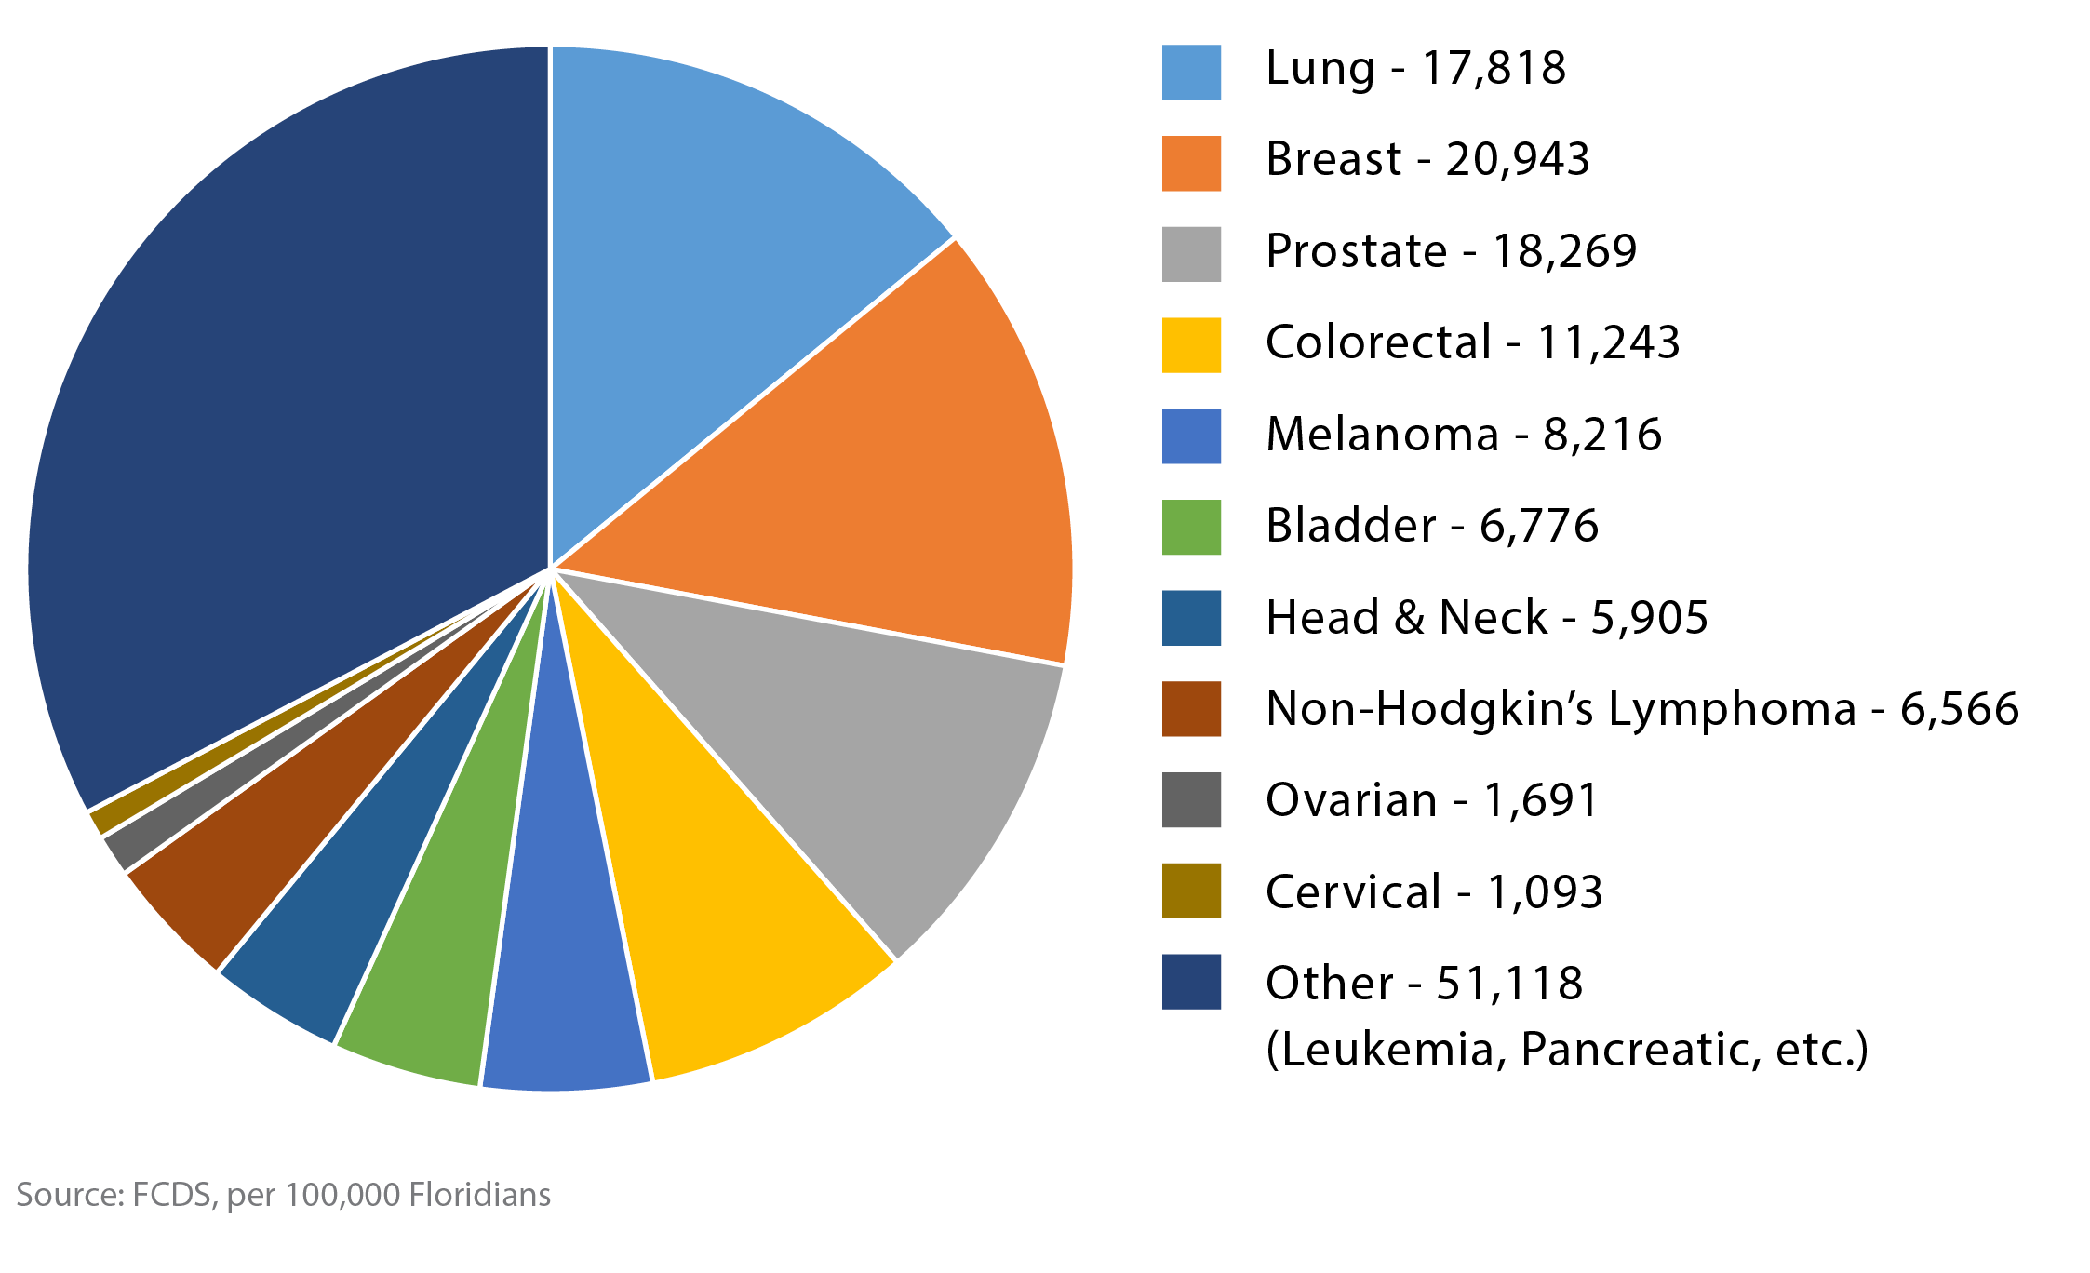
Crude Cancer Incidence (Number) by Cancer Type
THE STATE OF CANCER IN FLORIDA | 2024

Slide 8
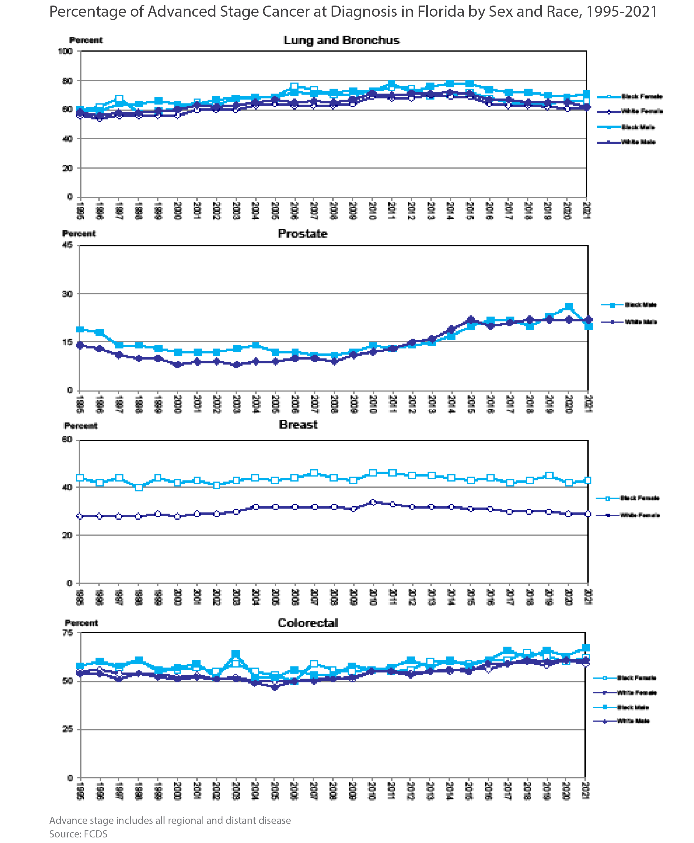
Percentage of Advanced Stage Cancer Diagnosis in Florida by Sex and Race, 1995-2021
THE STATE OF CANCER IN FLORIDA | 2024

Slide 9
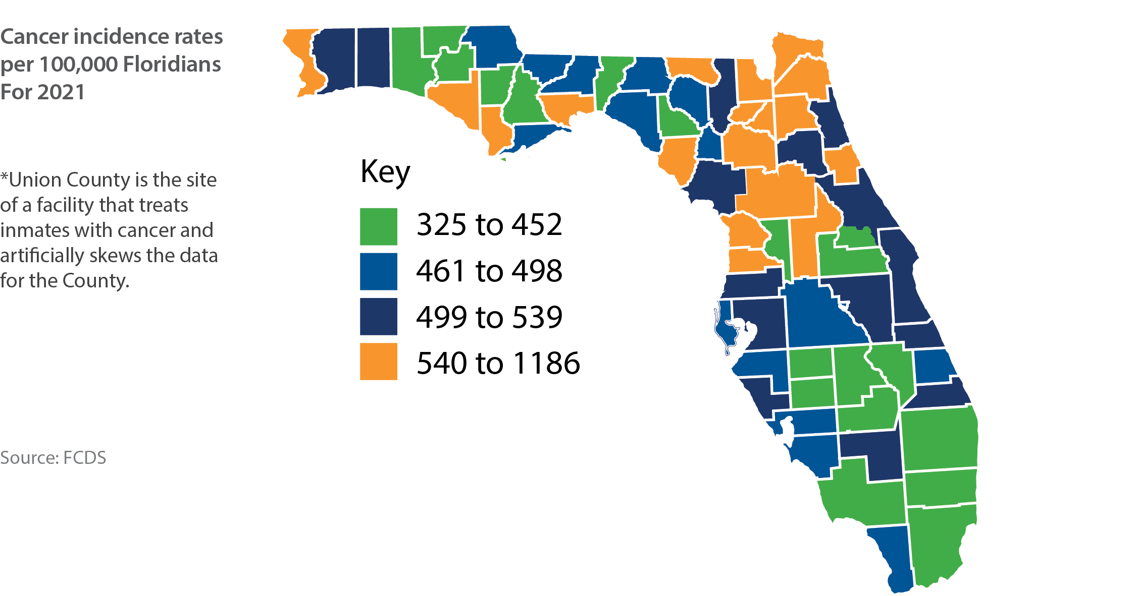
Florida Map of Cancer Incidence by County
THE STATE OF CANCER IN FLORIDA | 2024

Slide 10
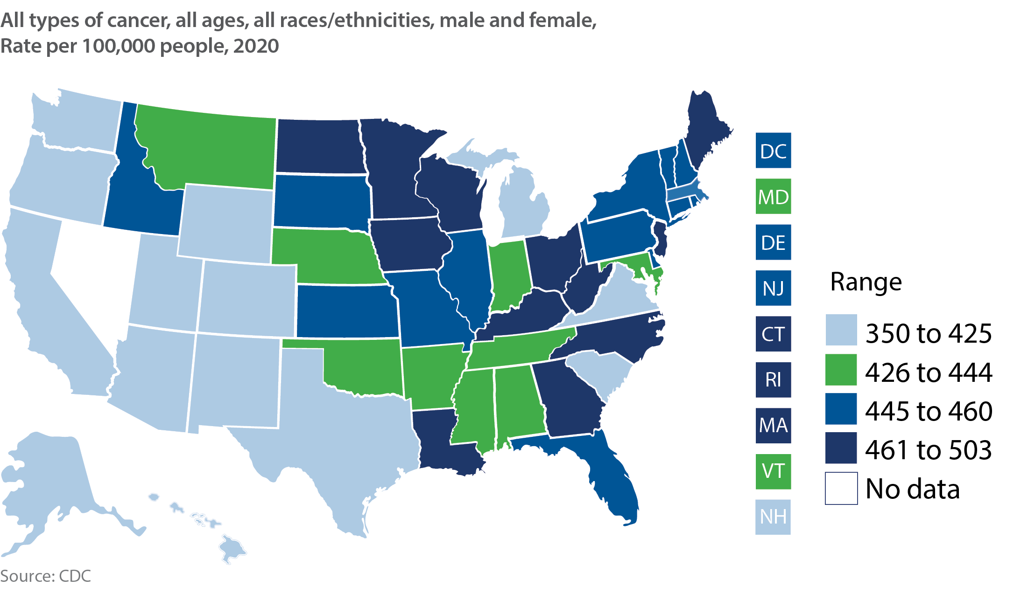
US Map of Cancer Incidence
THE STATE OF CANCER IN FLORIDA | 2024

Slide 11
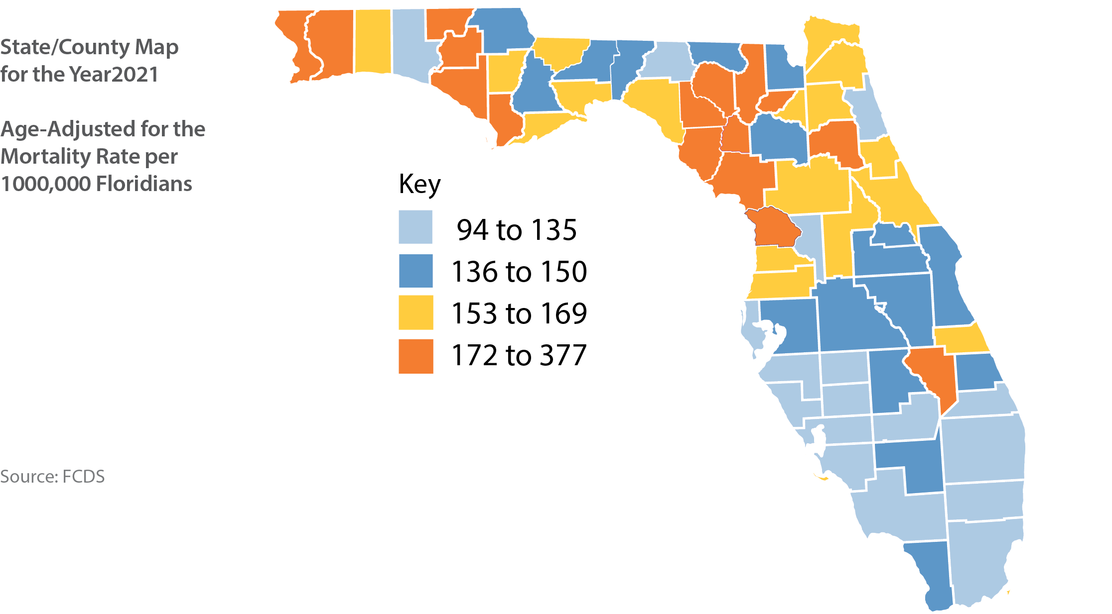
Florida Map of Cancer Mortality by County
THE STATE OF CANCER IN FLORIDA | 2024

Slide 12
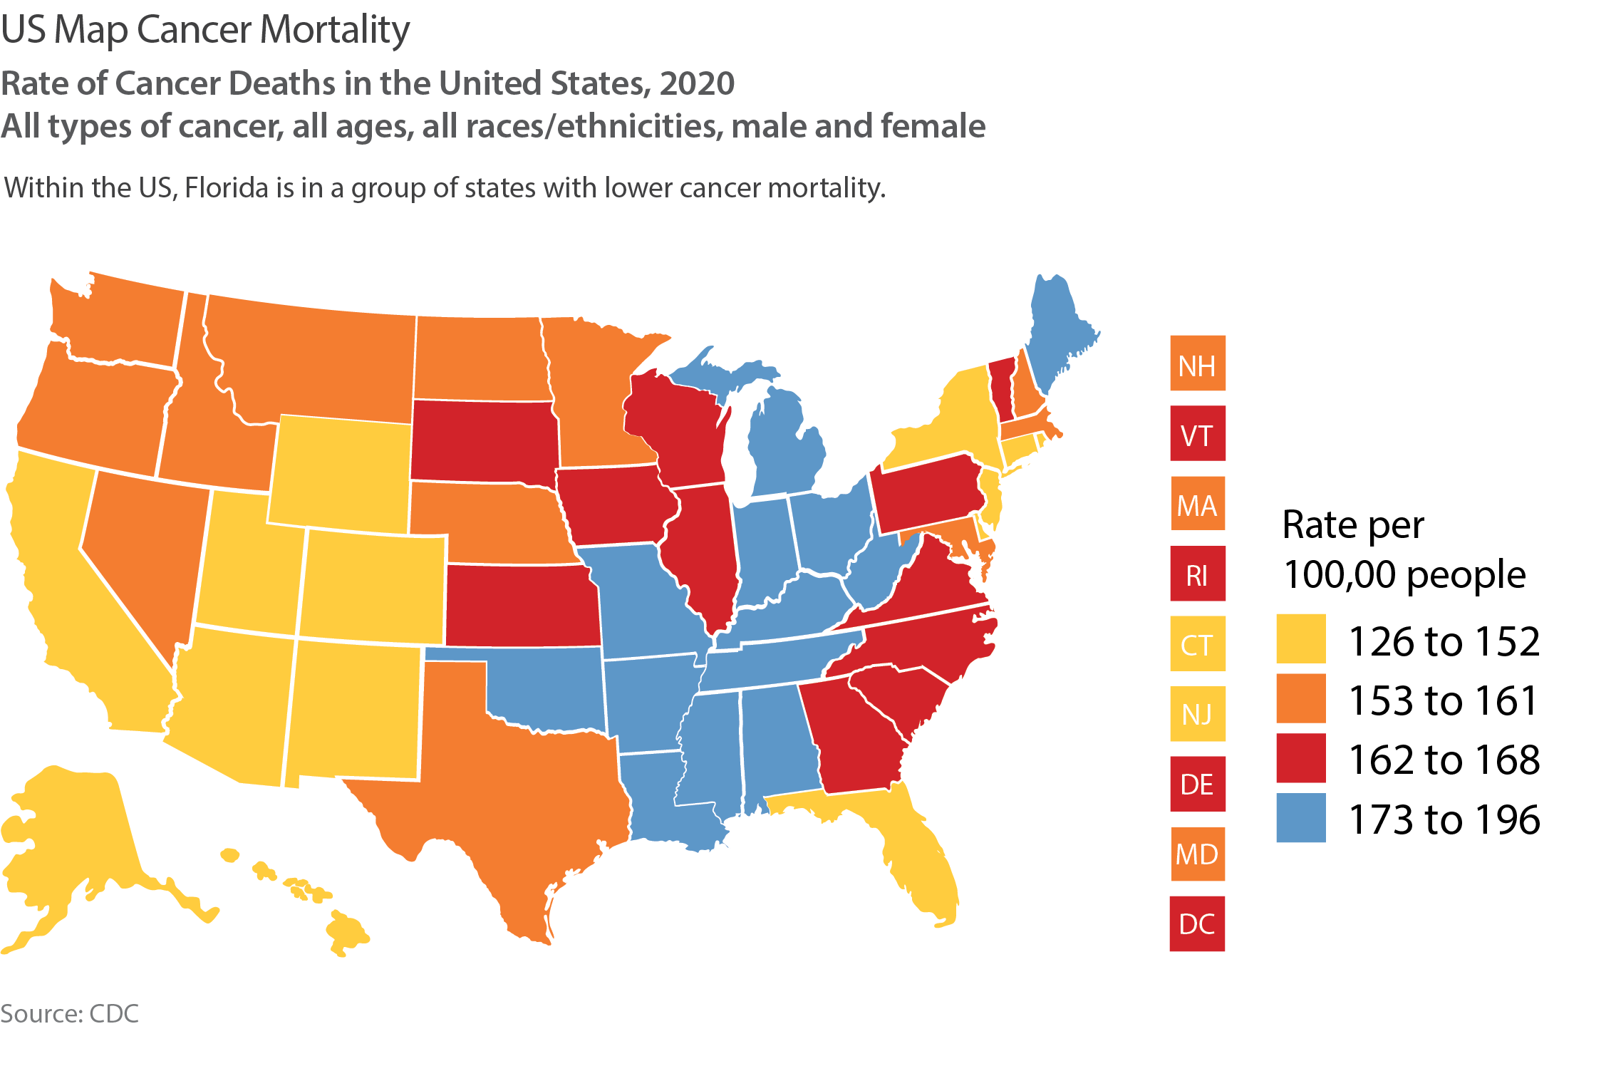
US Map Cancer Mortality
THE STATE OF CANCER IN FLORIDA | 2024

Slide 13
Pediatric Cancer Mortality in Florida
THE STATE OF CANCER IN FLORIDA | 2024

Slide 14
Pediatric Cancer Incidence in Florida
THE STATE OF CANCER IN FLORIDA | 2024

Slide 15
HPV Vaccination in Florida
THE STATE OF CANCER IN FLORIDA | 2024

Slide 16
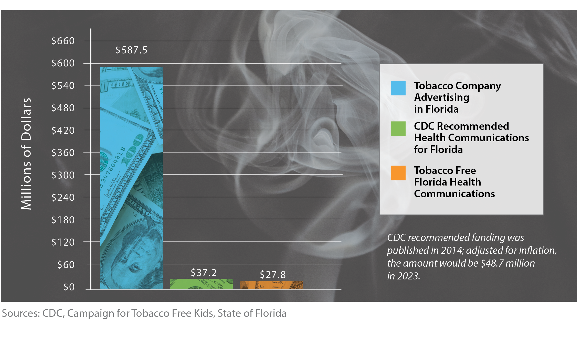
Annual Spending for Tobacco-Related Communications
THE STATE OF CANCER IN FLORIDA | 2024

Slide 17
Florida Cancer Centers of Excellence
THE STATE OF CANCER IN FLORIDA | 2024

Slide 18
THE STATE OF CANCER IN FLORIDA | 2024

Slide 19
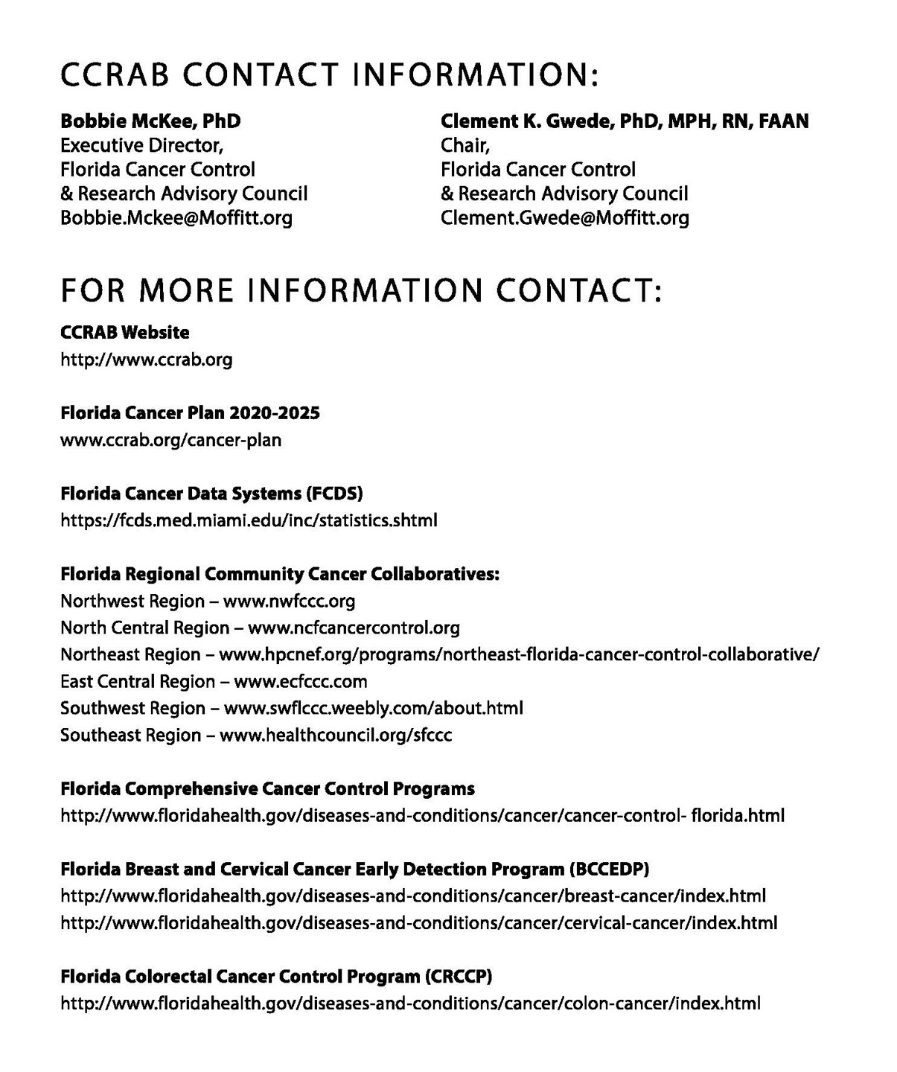
THE STATE OF CANCER IN FLORIDA | 2024

Slide 20
THE STATE OF CANCER IN FLORIDA | 2024

