Slide 2
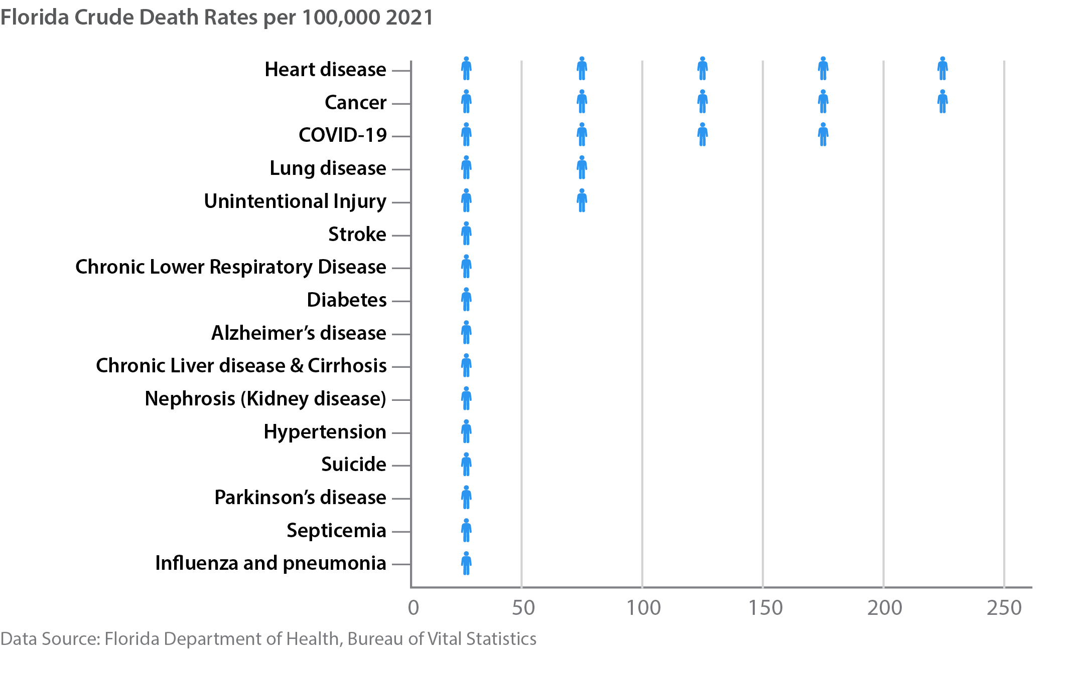
Leading Causes of Death in Florida

Slide 3
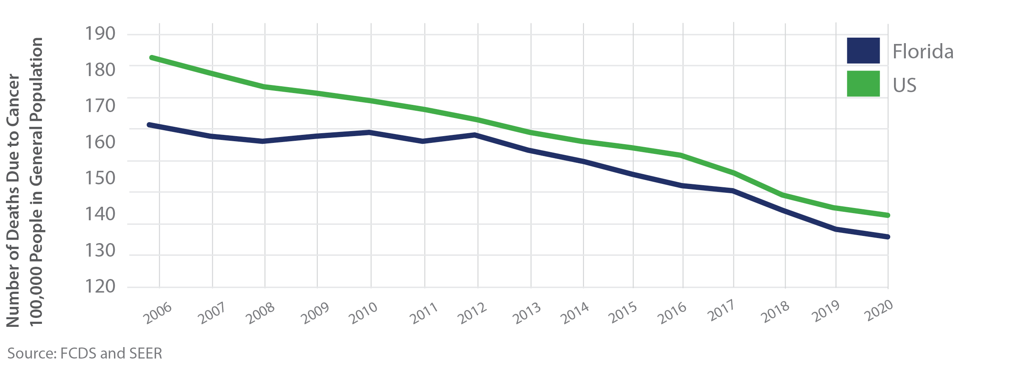
Cancer Mortality in Florida vs. the United States

Slide 4
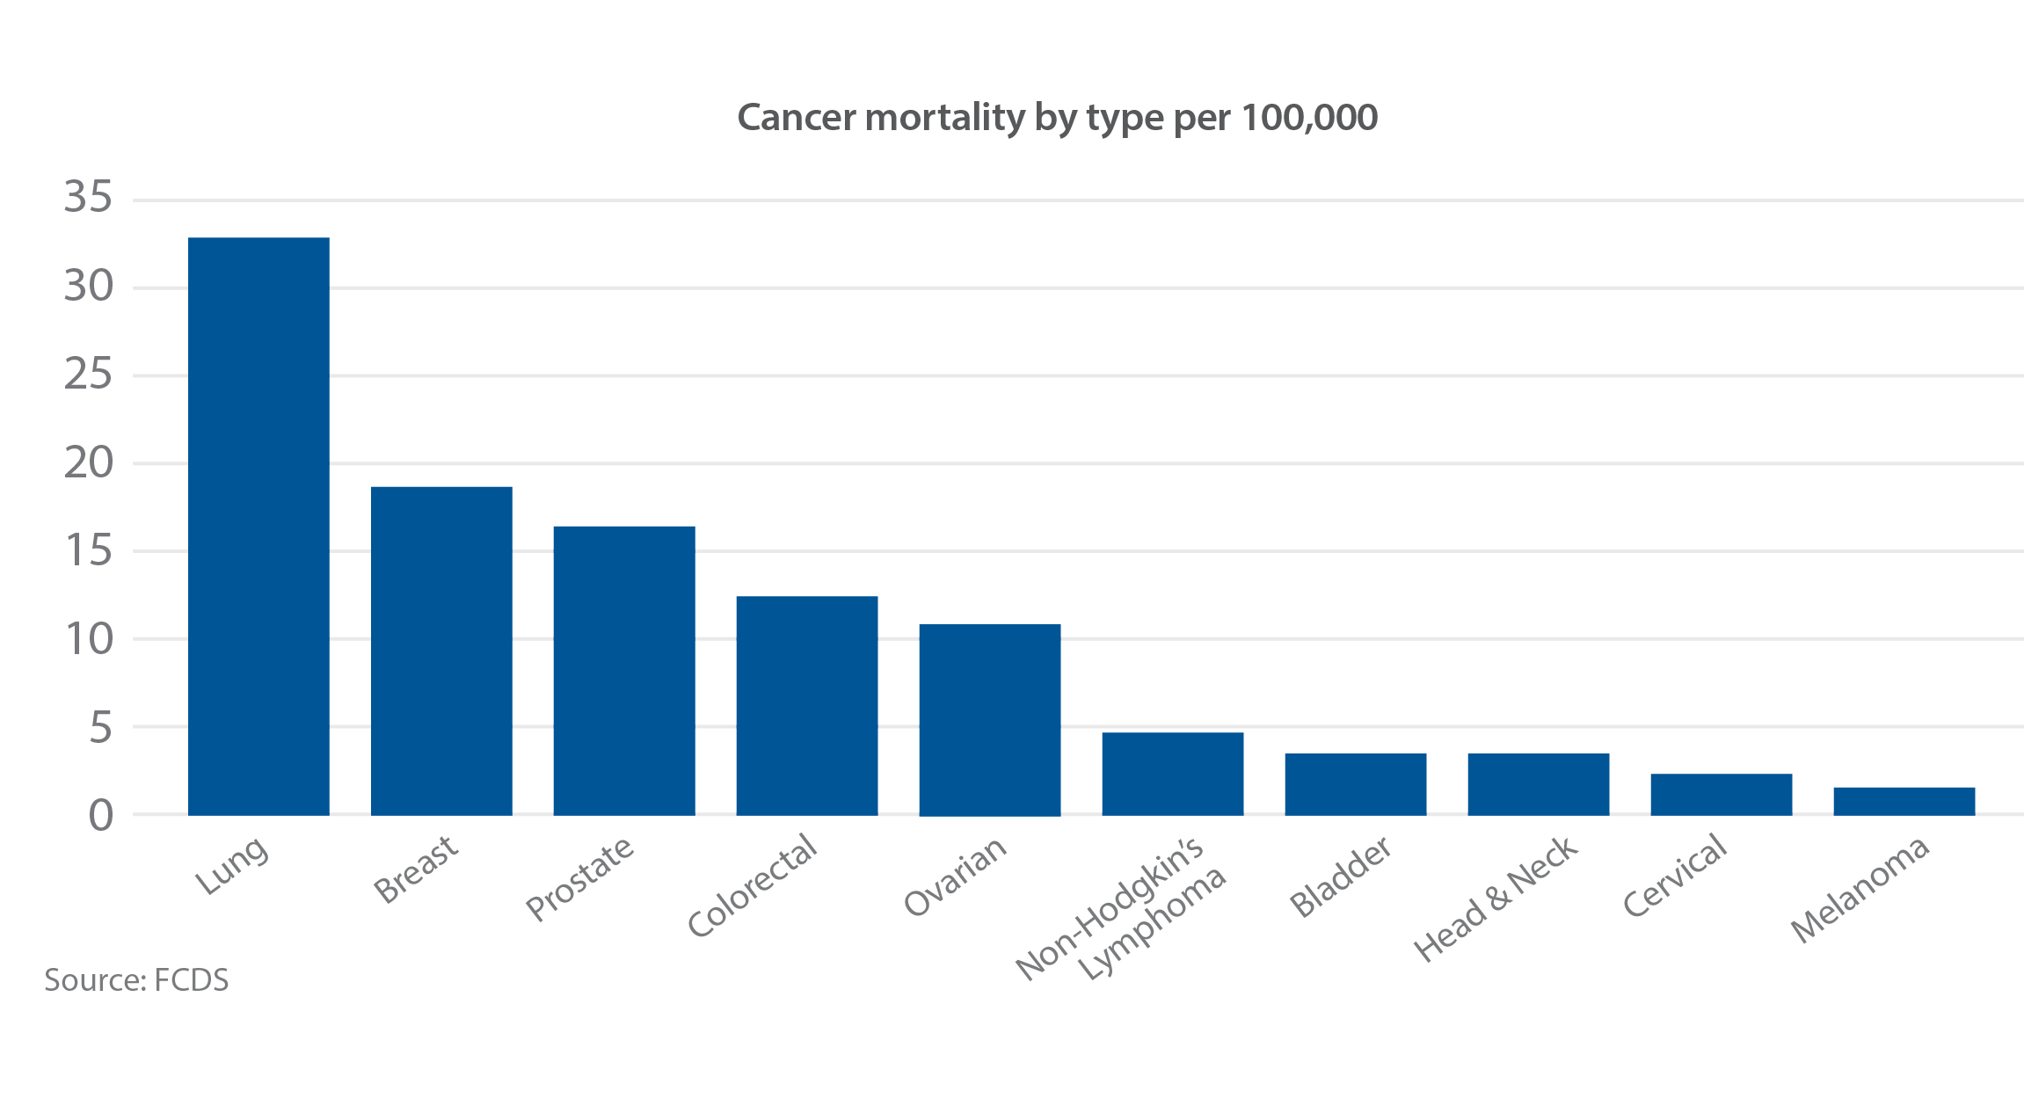
Cancer Mortality by Type in Florida, 2020

Slide 5
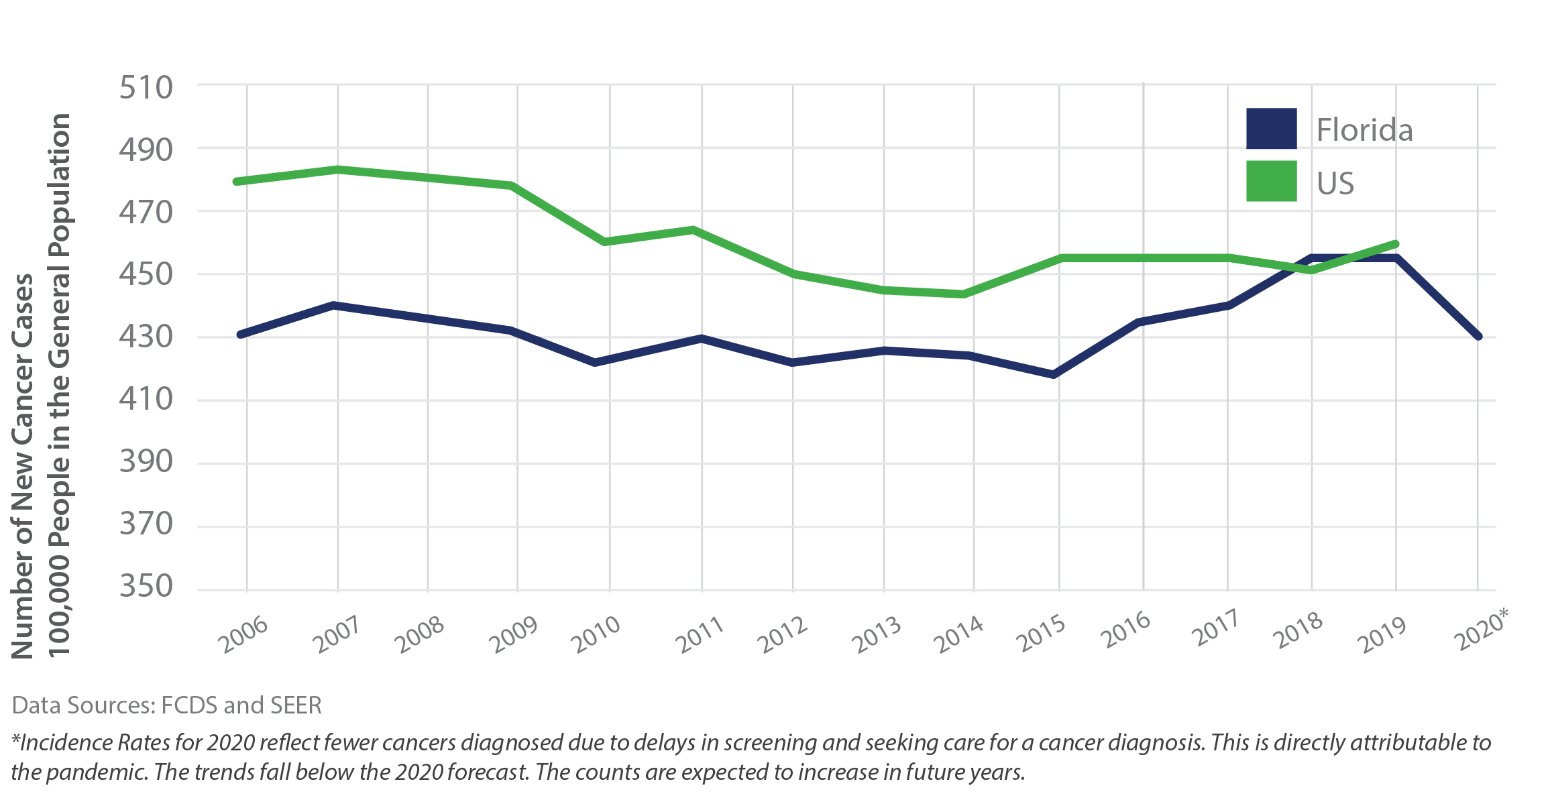
Cancer Incidence in Florida vs. the United States

Slide 6
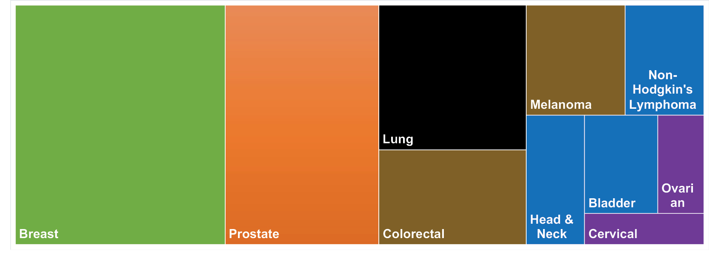
Age-Adjusted Cancer Incidence by Type in Florida

Slide 7
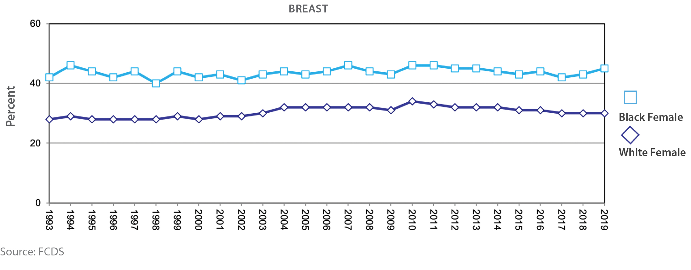
Percentage of Advanced Stage Breast Cancer at
Diagnosis by Race, 1993-2019

Slide 8
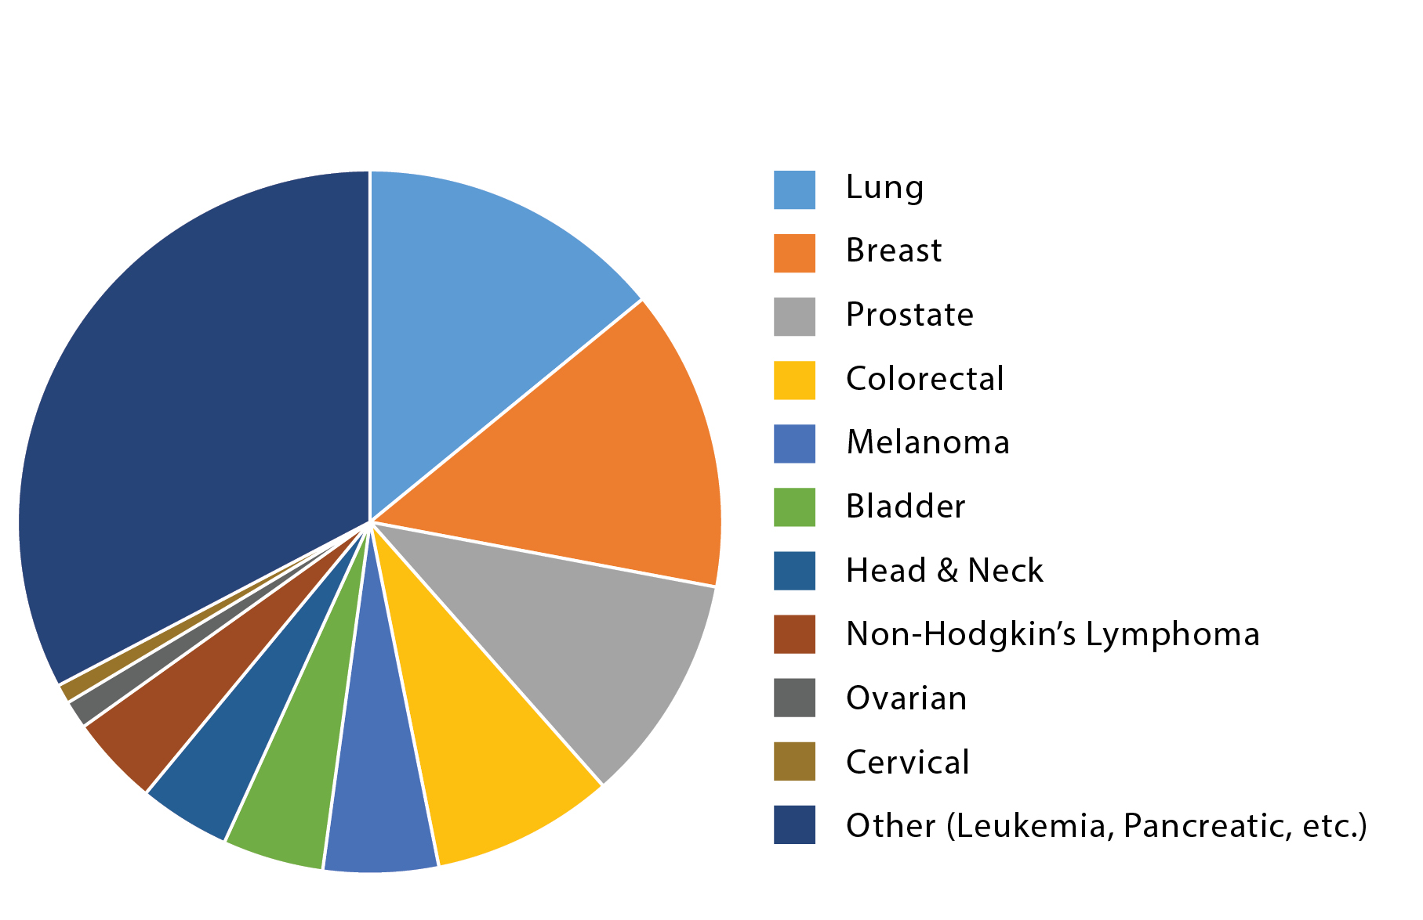
Crude Cancer Incidence (Number) by Cancer Type
Source: FCDS

Slide 9
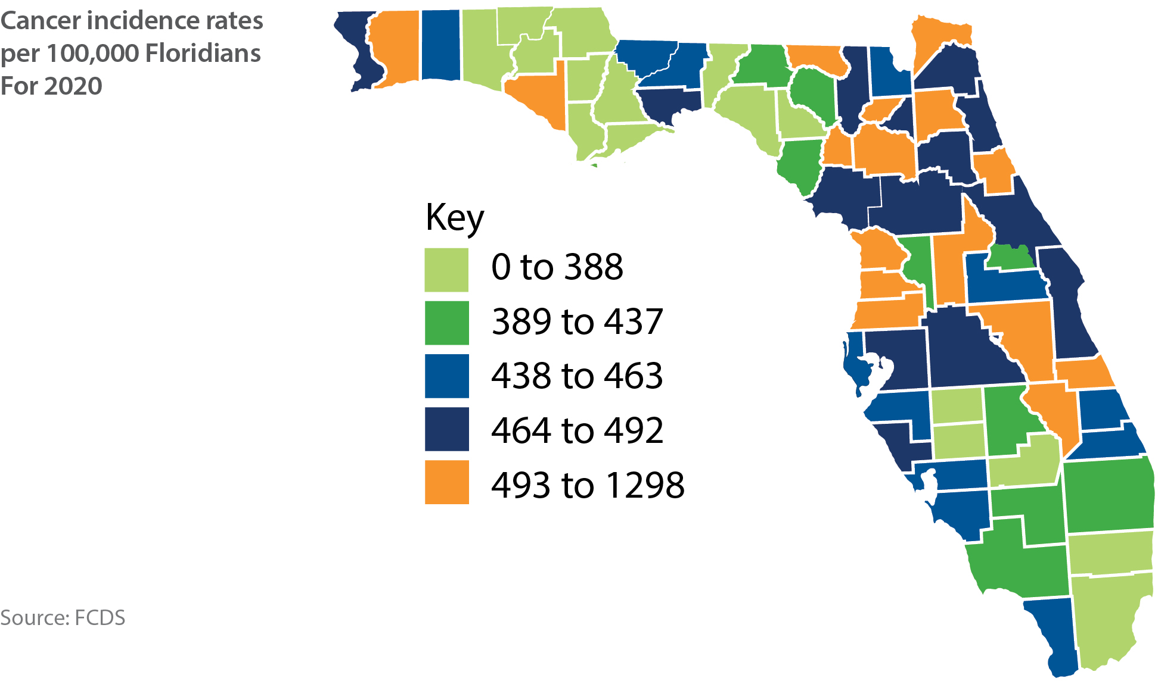
Florida Map of Cancer Incidence by County

Slide 10
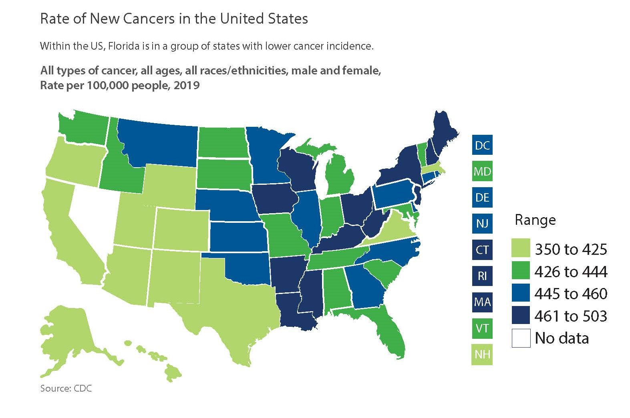
US Map of Cancer Incidence

Slide 11
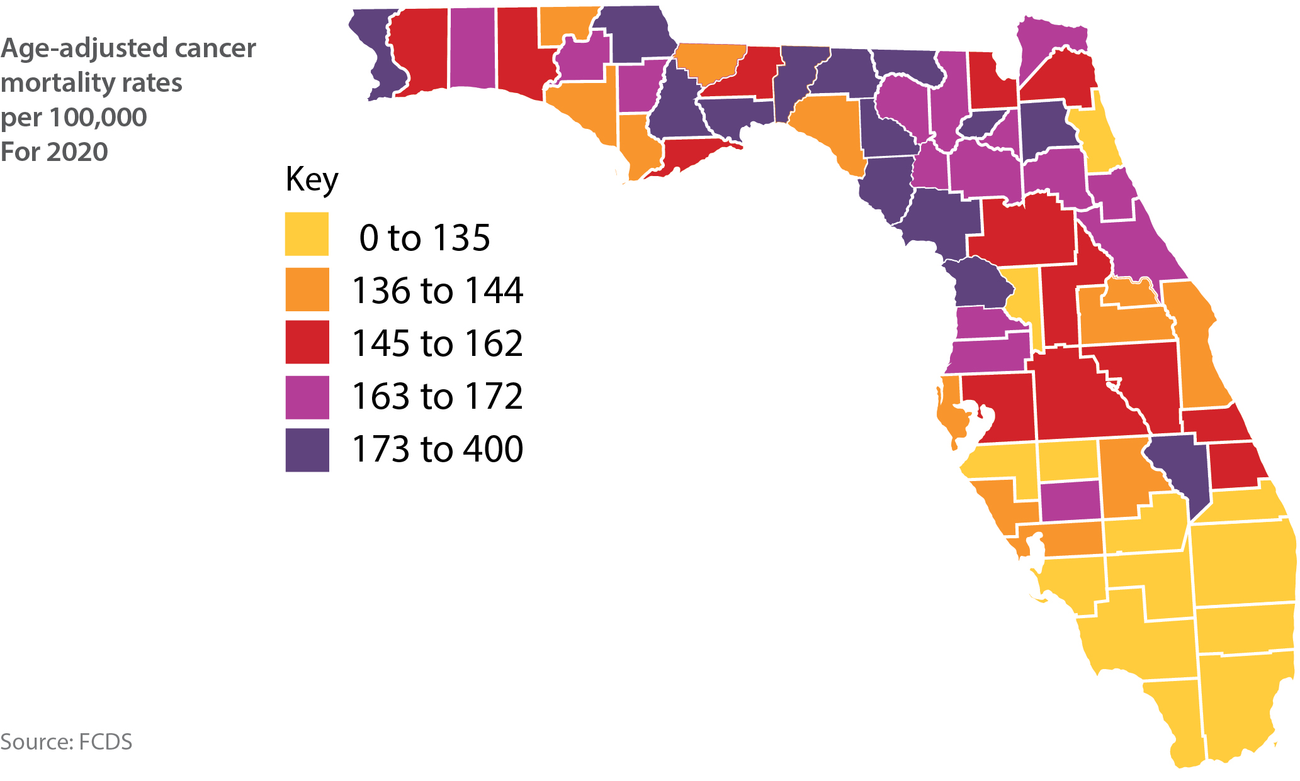
Florida Map of Cancer Mortality by County

Slide 12
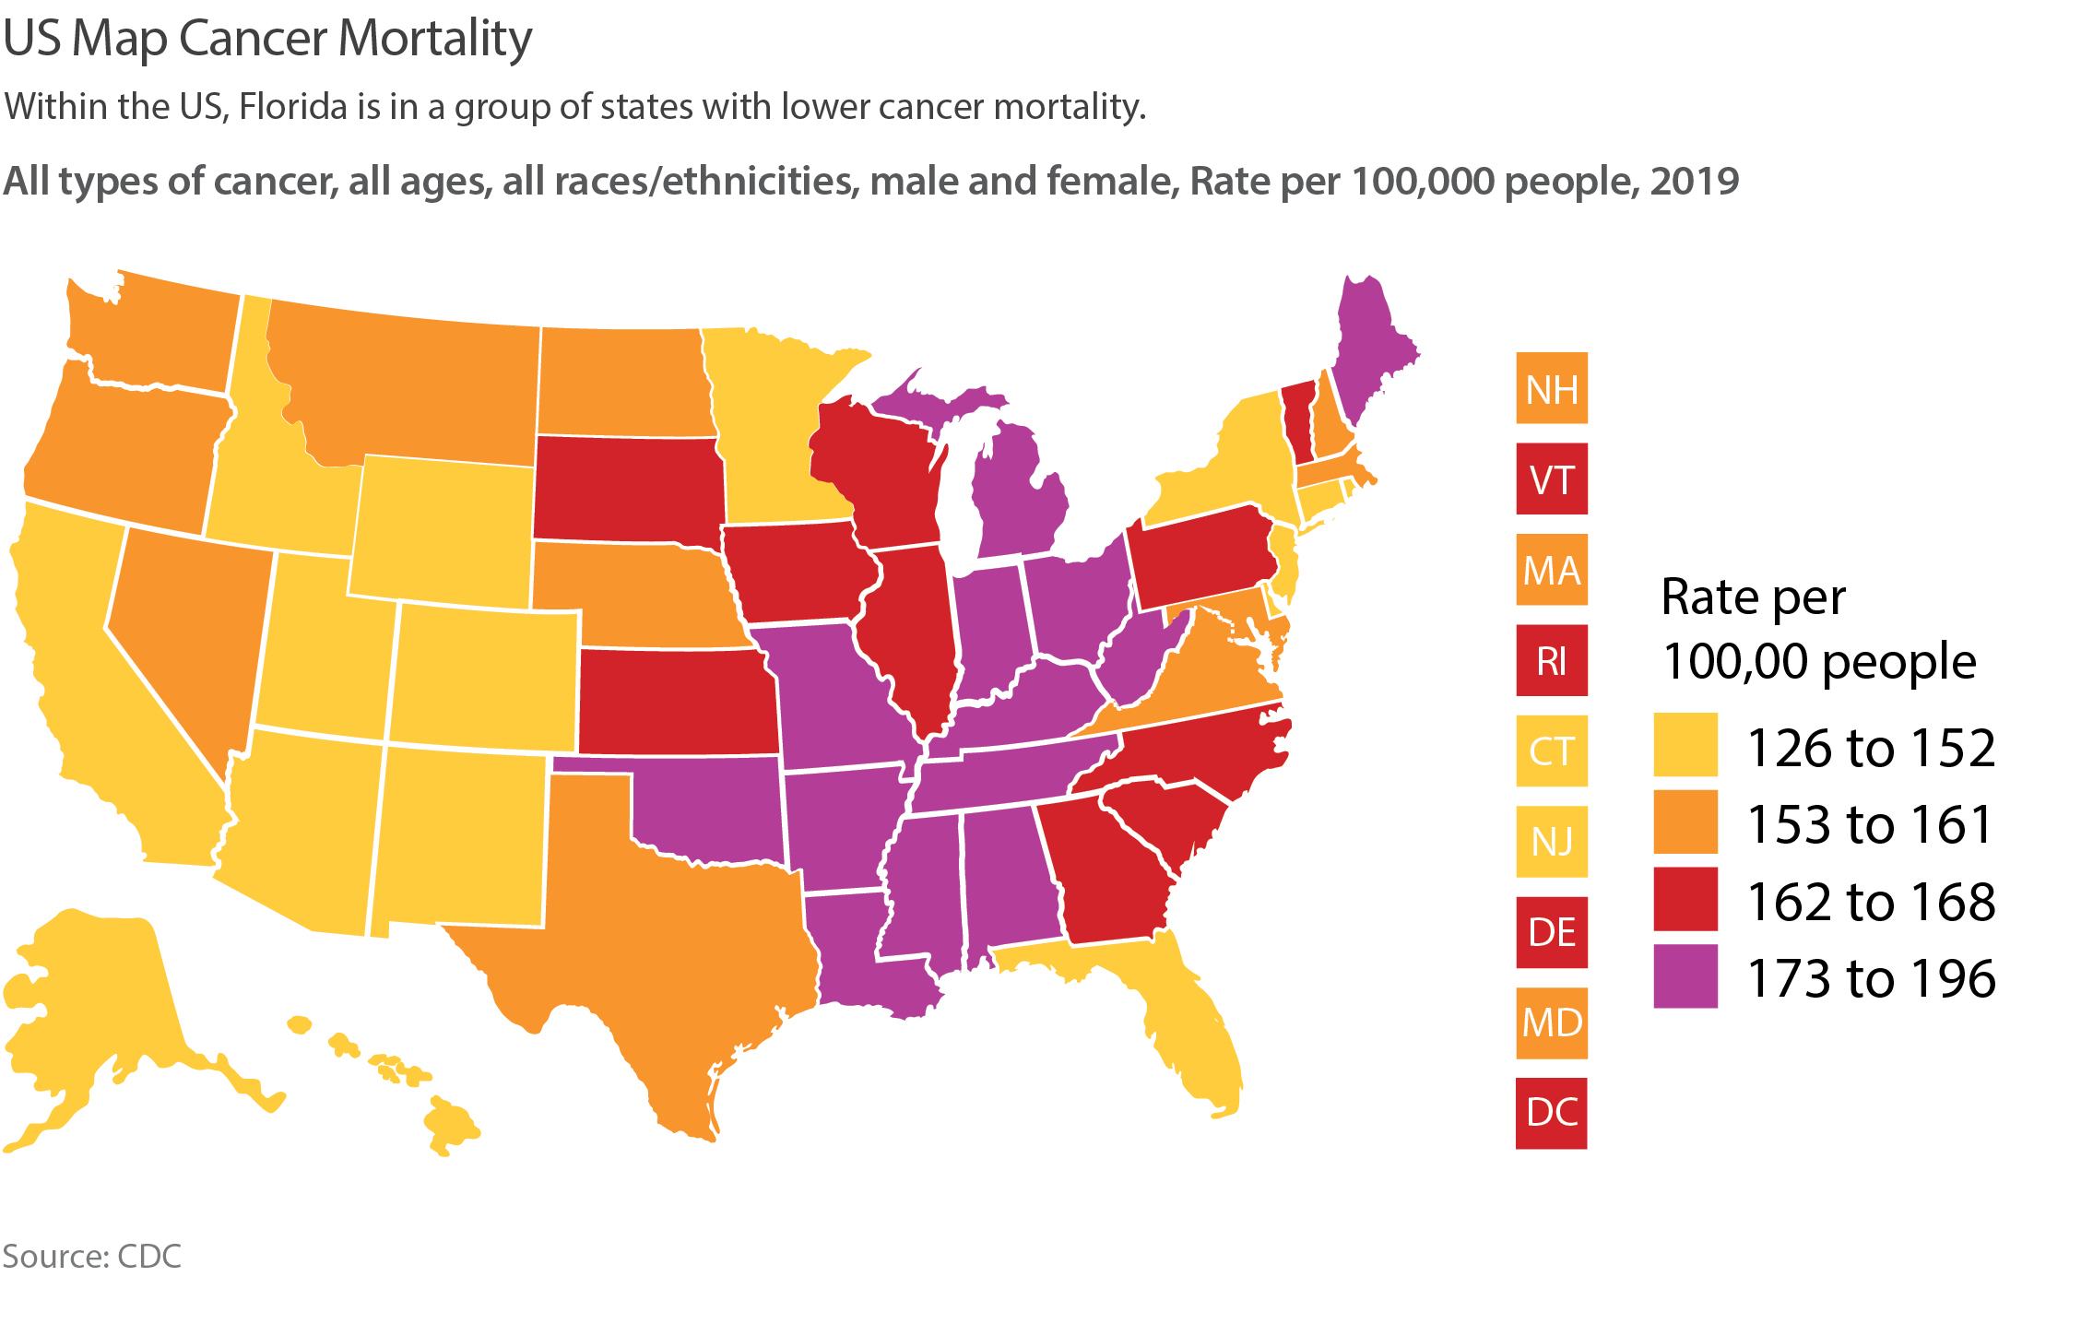
US Map Cancer Mortality

Slide 13
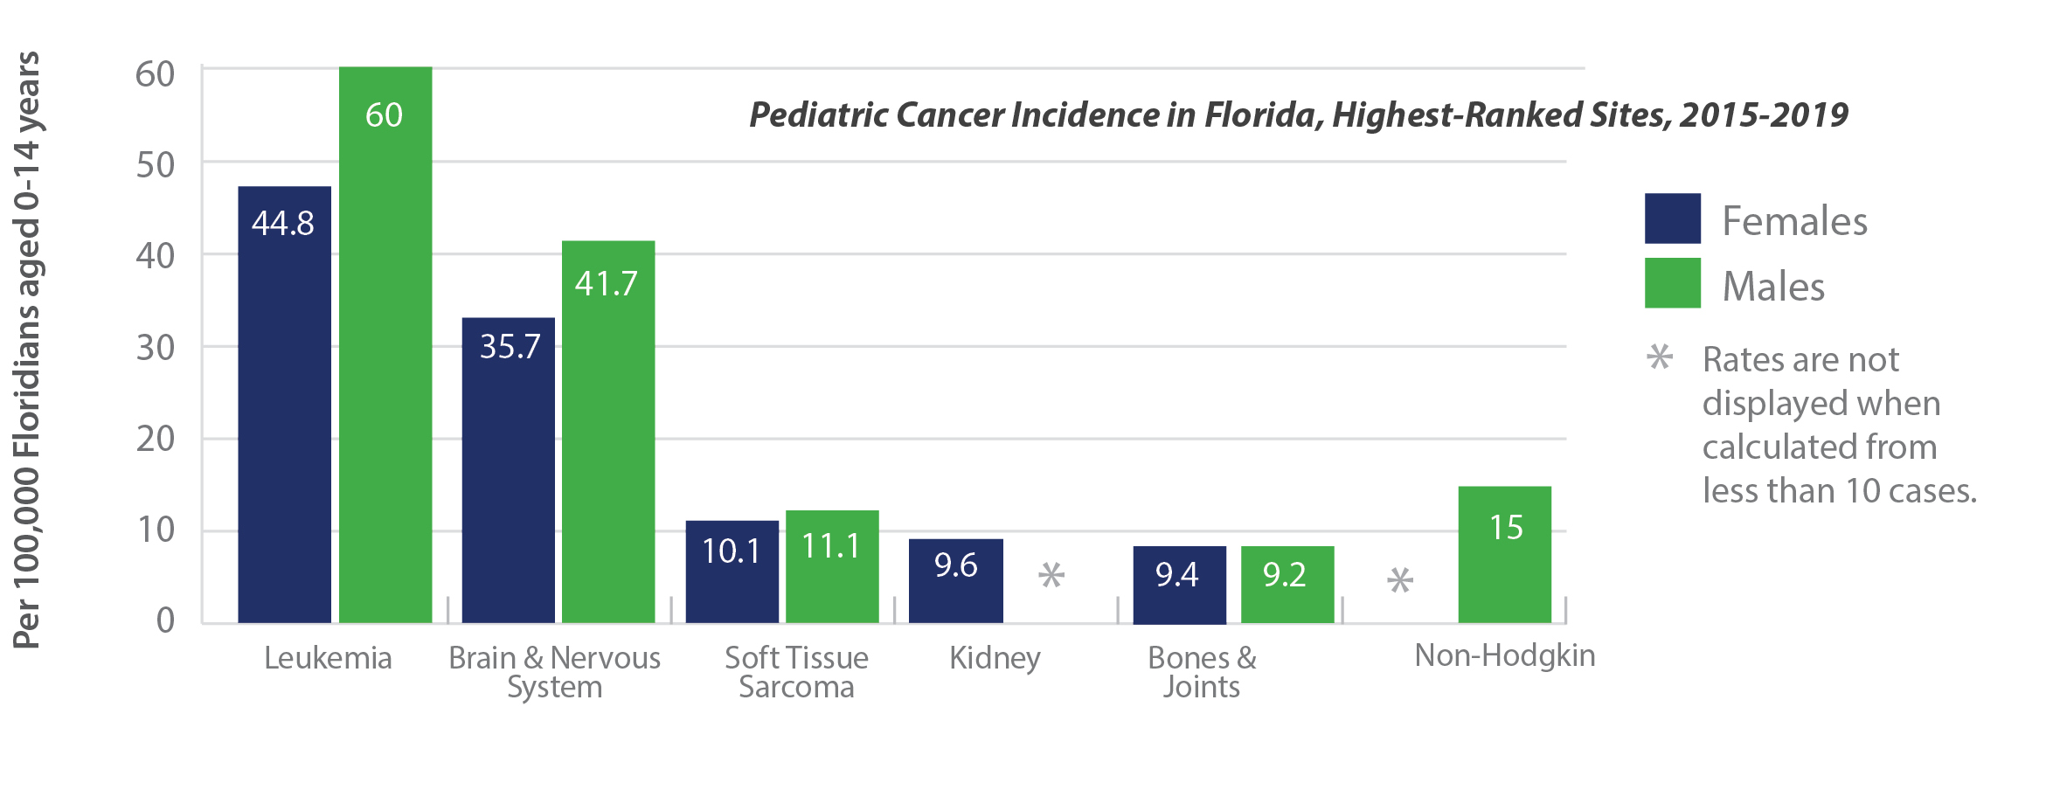
Pediatric Cancer in Florida

Slide 14
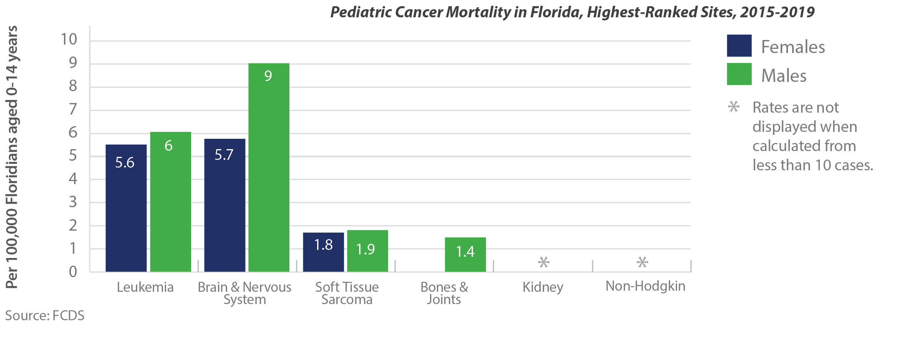
Pediatric Cancer in Florida

Slide 15
HPV Vaccination in Florida

Slide 16
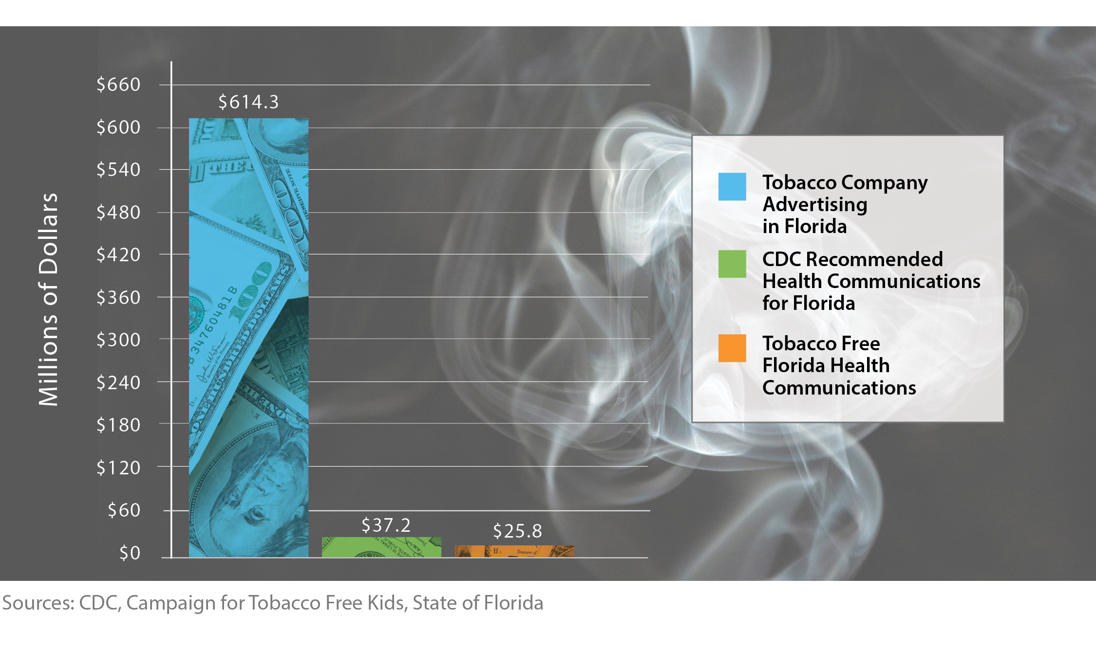
Annual Spending for Tobacco-Related Communications

Slide 17
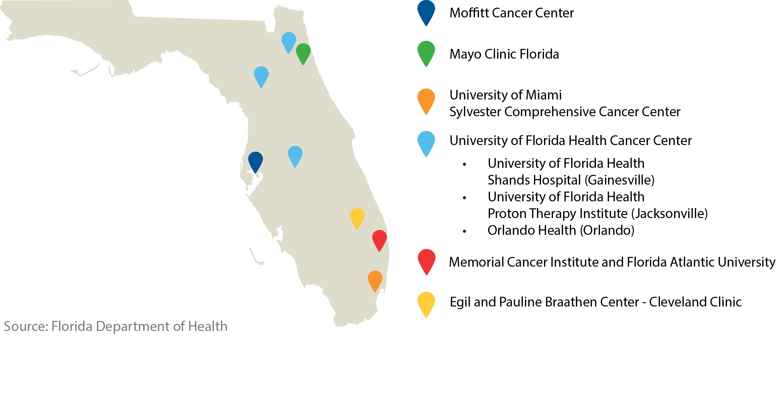
Florida Cancer Centers of Excellence

Slide 19
