Slide 2
Led by

Slide 3
The gift…
The gift is given as a result of a child passing too soon from this world and the unimaginable loss family and friends endure.
The gift provides an invaluable resource for advancing research to improve treatments and outcomes for children who are diagnosed with brain cancer.
After donation, families have the right to know how their child’s tissue is used.
Families are kept informed by the researchers
Led by

Slide 4
CNS-based Program
Goals
Allow families to donate tissue at the end of life unrestricted by their geographical location
Effect a cultural change around post-mortem tissue donation
Metric Reporting & Data Sharing for Cancer Research
Led by

Slide 5
Centers of Excellence
Centers of Excellence are regional sites for coordination, processing and storage of donated tissue.
Led by

Slide 6
Regional Centers of Excellence
Coordinate + process whole brain +spinal cord tissue donation & generate preclinical models of the disease
All brain tumor types will be received
Share Specimens with CBTN Bio-Repository
Share Specimens with labs of Family’s choice (if possible)
Develop a network of satellite resources to facilitate donations within the center’s region
Report metrics @ www.GiftFromAChild.org

Slide 7
Overall Aims
Create awareness & education about the GFAC/COG Autopsy Initiative Programs, locally and statewide.
Create a network for advocacy and referrals to the Centers of Excellence
Local Hospitals
Hospices
Funeral Homes
Funeral Directors Association
National Association of Medical Examiners
Create educational programs for residents and fellows, pediatric oncologists, social workers, child life specialists, oncology nurses/advanced practice providers
Create community and support for families surrounding the lasting value of this gift

Slide 8
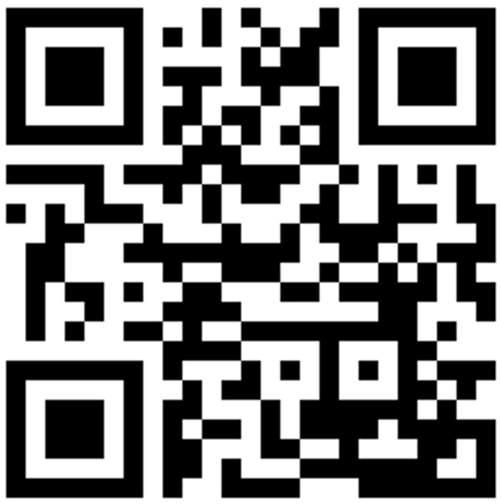
Thank you! Please visit GiftFromAChild.org >> for more information

